Slide 1
Path planning problem Algorithms reviews
Amit Bouzaglo

Slide 2
Autonomous Navigation
Goal
Develop techniques that would allow a robot to automatically decide how to move from position one to another.
Steps:
Localization (GPS, INR, sensors)
Mapping (obstacles, roads, POI)
Path-planning
Path-following

Slide 3

Mapping
START
 |  |  |  |  |  | END
Grid to Graph
Graph: $G\left(V,E\right)$
V – Vertexes (Nodes)
E – Edges

Slide 4
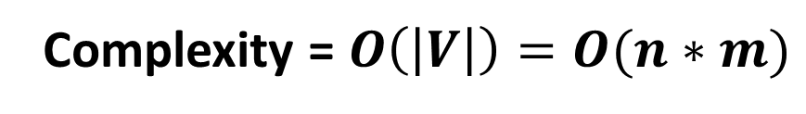
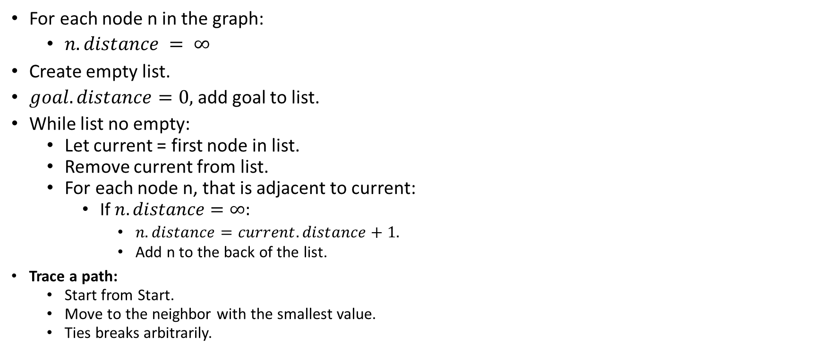
Grassfire Algorithm (BFS)
9 | 8 | 7 | 6 | 5 | 6
8 | 7 | 6 | 5 | 4
7 |  |  |  | 3 | 2 | 3
6 | 5 | 4 |  | 2 | 1 | 2
 | 4 | 3 | 2 | 1 | 0 | 1
 |  | 4 | 3 | 2 | 1 | 2
For each node n in the graph:
$n.distance = ∞$
Create empty list.
$goal.distance=0,$add goal to list.
While list no empty:
Let current = first node in list.
Remove current from list.
For each node n, that is adjacent to current:
If $n.distance=∞:$
$n.distance=current.distance+1.$
Add n to the back of the list.
Trace a path:
Start from Start.
Move to the neighbor with the smallest value.
Ties breaks arbitrarily.
Complexity = $O\left(\left|V\right|\right)=O(n∗m)$

Slide 5

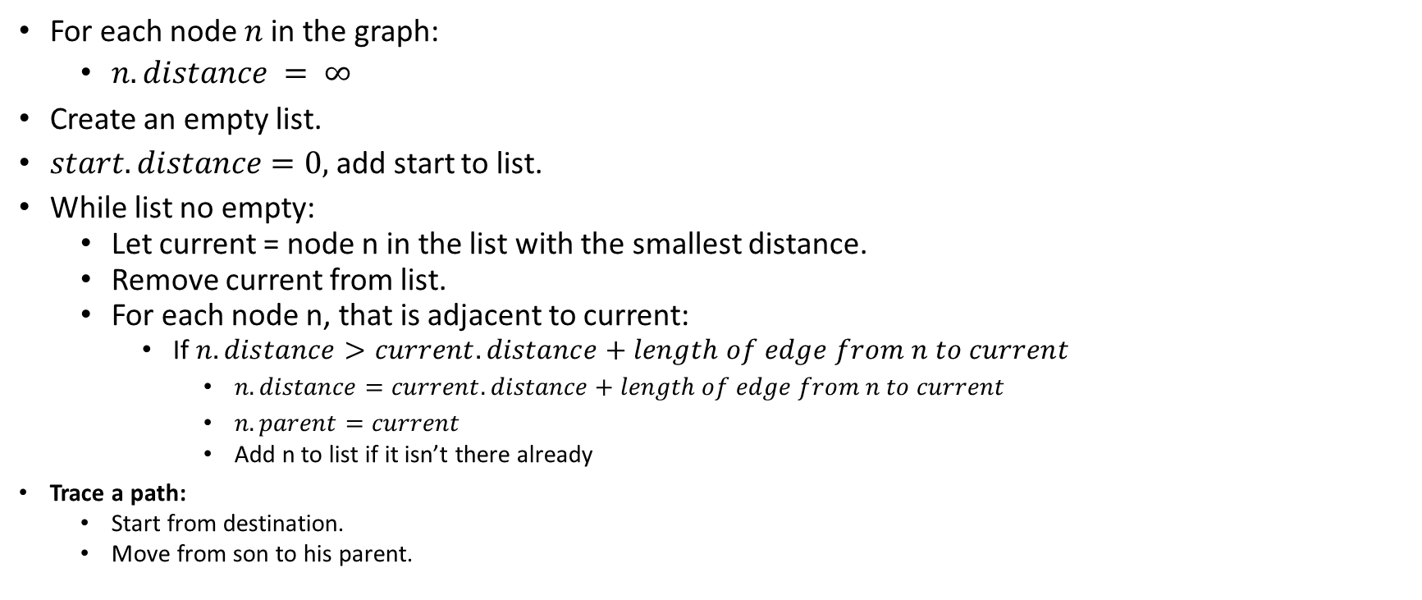
Dijkstra's Algorithm (BFS)
B,1
A,0
1
7
C,5
3
2
3
For each node $n$ in the graph:
$n.distance = ∞$
Create an empty list.
$start.distance=0,$add start to list.
While list no empty:
Let current = node n in the list with the smallest distance.
Remove current from list.
For each node n, that is adjacent to current:
If $n.distance>current.distance+length of edge from n to current$
$n.distance=current.distance+length of edge from n to current$
$n.parent=current$
Add n to list if it isn’t there already
Trace a path:
Start from destination.
Move from son to his parent.
5
1
D,2
F,5
4
9
E,6
G,9
Complexity = $O(\left(\left|E\right|+\left|V\right|\right)log(\left|V\right|))$

Slide 6
Quick summary
Dijkstra/Grassfire Algorithm explores evenly in all directions until it finds the gold node.
Could we do better?
YES!
Using the information we already have.
The destination…

Slide 7

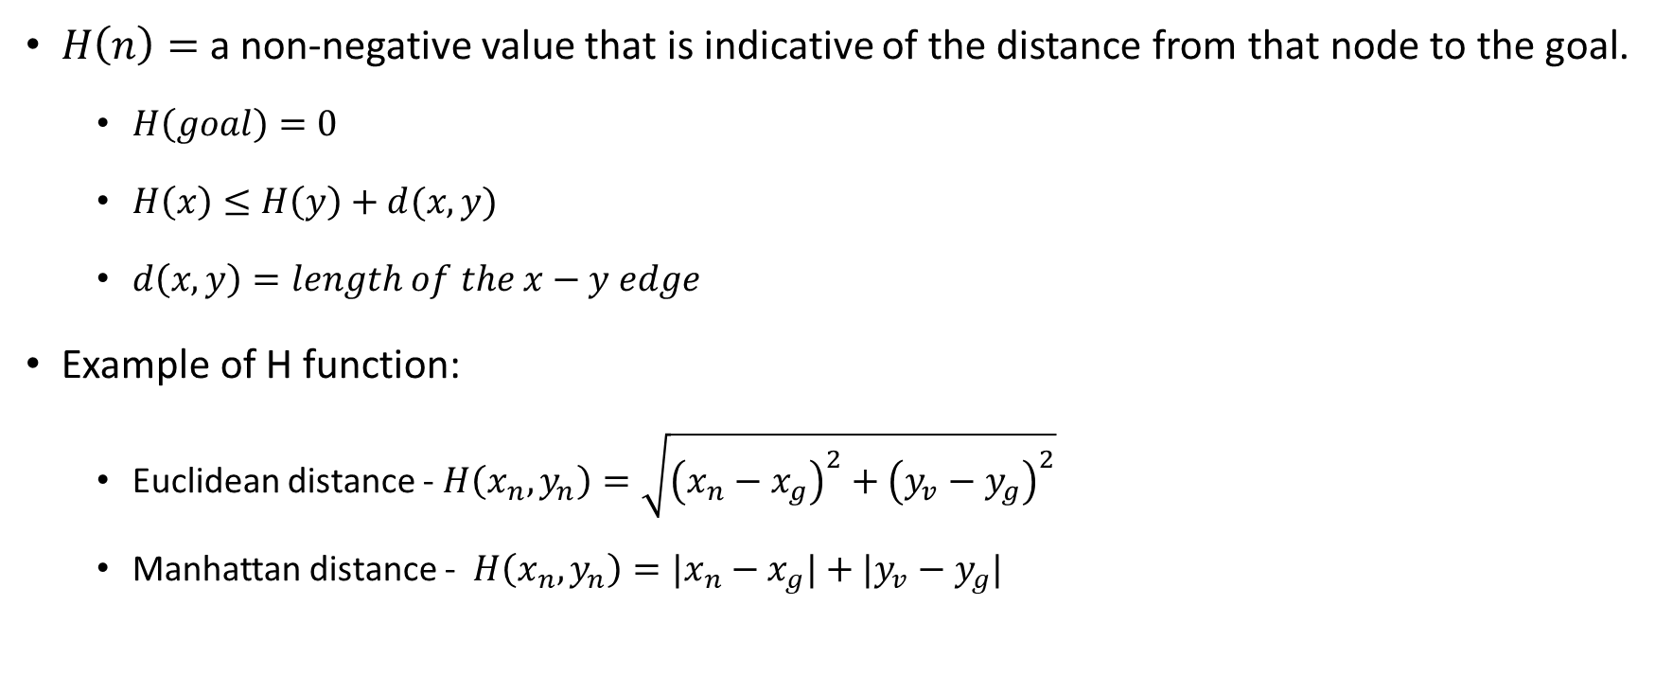


Heuristic function H(n)
$H\left(n\right)=$a non-negative value that is indicative of the distance from that node to the goal.
$H\left(goal\right)=0$
$H\left(x\right)≤H\left(y\right)+d(x,y)$
$d\left(x,y\right)=length of the x−y edge$
Example of H function:
Euclidean distance - $H\left(x_{n},y_{n}\right)=\sqrt{{\left(x_{n}−x_{g}\right)}^{2}+{\left(y_{v}−y_{g}\right)}^{2}}$
Manhattan distance - $H\left(x_{n},y_{n}\right)=|x_{n}−x_{g}|+|y_{v}−y_{g}|$
y
$$H(y)$$
$$d(x,y)$$
x
$$H(x)$$
goal

Slide 8
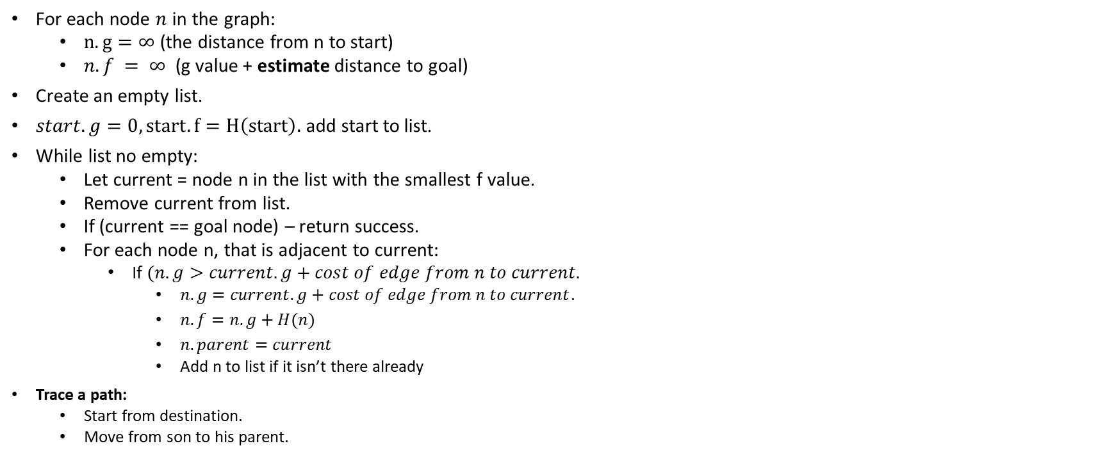
A* Algorithm (Best-FS)
For each node $n$ in the graph:
$n.g=∞$ (the distance from n to start)
$n.f = ∞$ (g value + estimate distance to goal)
Create an empty list.
$start.g=0, start.f=H\left(start\right).$add start to list.
While list no empty:
Let current = node n in the list with the smallest f value.
Remove current from list.
If (current == goal node) – return success.
For each node n, that is adjacent to current:
If $(n.g>current.g+cost of edge from n to current.$
$n.g=current.g+cost of edge from n to current$.
$n.f=n.g+H(n)$
$n.parent=current$
Add n to list if it isn’t there already
Trace a path:
Start from destination.
Move from son to his parent.
Complexity = Dijkstra’s complexity (worst case)

Slide 9
D* Algorithm
Suitable for use in a dynamic or complex environment
RAISE-STATE:
PROCESS-STATE (backward step):
Compute optimal path to the goal.
Initially set h(End) = 0 and insert it into the OPEN list.
Repeatedly called until the robot’s state Start is removed from the OPEN list.
Determine optimal path by following gradient of h values. (forward step)
MODIFY-COST:
Immediately called, once the robot detects an error in the arc cost function (i.e. discover a new obstacle)
Change the arc cost function and enter affected states on the OPEN list.
Complexity = $O\left(\left|E\right|log\left(\left|V\right|\right)\right)$ (worst case)

Slide 10
D* Lite Algorithm
A* from End to Start (save the date!)
Start moving from start according the path planed.
When obstacle occurred:
Replan – only the necessary area.
D*-Lite is considered much simpler than D*, and since it always runs at least as fast as D*, it has completely obsoleted D*.
Complexity = $O\left(\left|E\right|log\left(\left|V\right|\right)\right)$ (worst case)

Slide 11
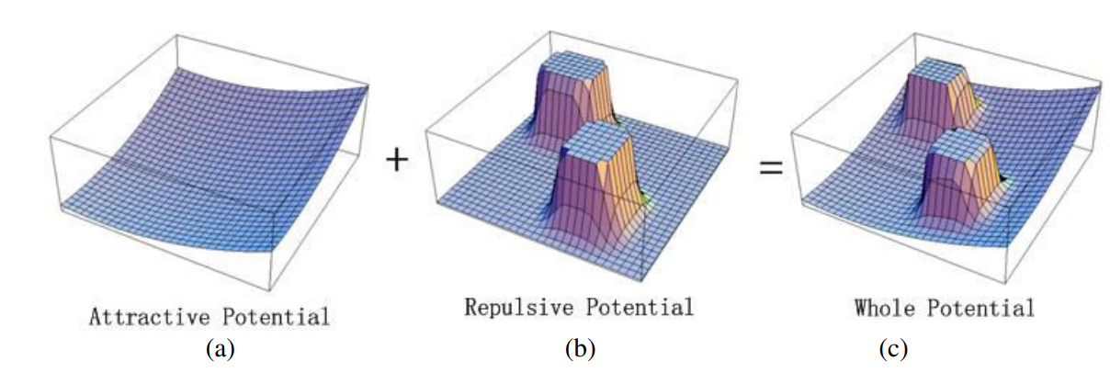
Potential Field Algorithm
Create APT model
Potential field calculation (gradient descent)
Start movement at starting point
If (goal reached)
Stop navigation
Else:
If obstacle is detected:
APF model
Potential field calculation
Turning angel to find safe position
if: (goal eached):
Stop navigation
Else if (obstacle):
Repeat APF
Else:
Keep navigate till goal is reached
Complexity = $O(\left|V\right|∗dimension)$

Slide 12
Random algorithms

Slide 13
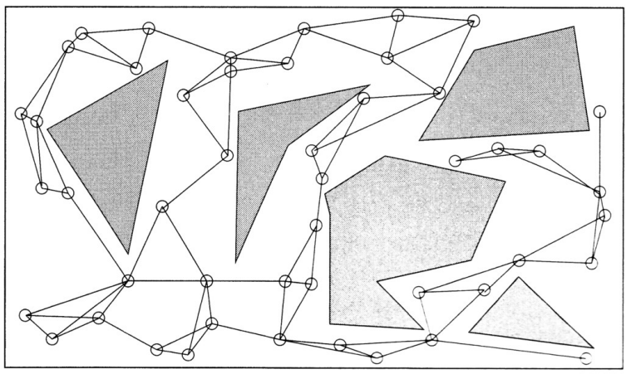
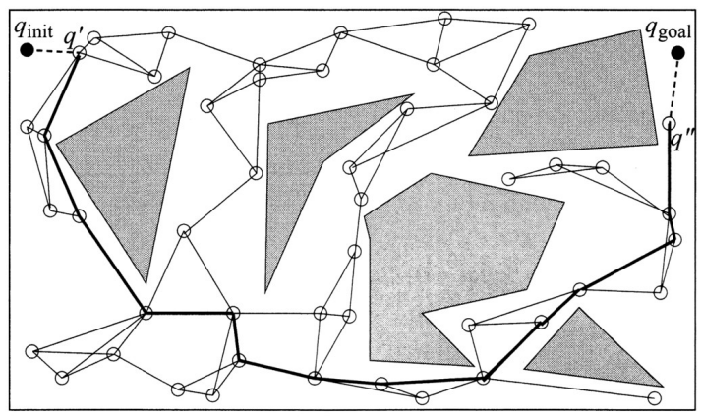
Probabilistic Road-Map (PRM) Algorithm
Step 1 – learning the map:
Initially empty graph – G (V,E).
Chose q randomly.
If q is free (collision detection) add to G.
Repeat until N nodes chosen.
For each q’ select k closest neighbors:
For each neighbor – connect q to neighbors q’.
If connect successful – add edge (q,q’) to G.
Step 2 – Finding a Path
Connect start and goal to exist G:
Find k nearest neighbors of start and goal in roadmap.
Connect start and goal to some exist nodes.
Use Dijkstra algorithm.
Complexity = Dijkstra’s complexity (worst case)

Slide 14
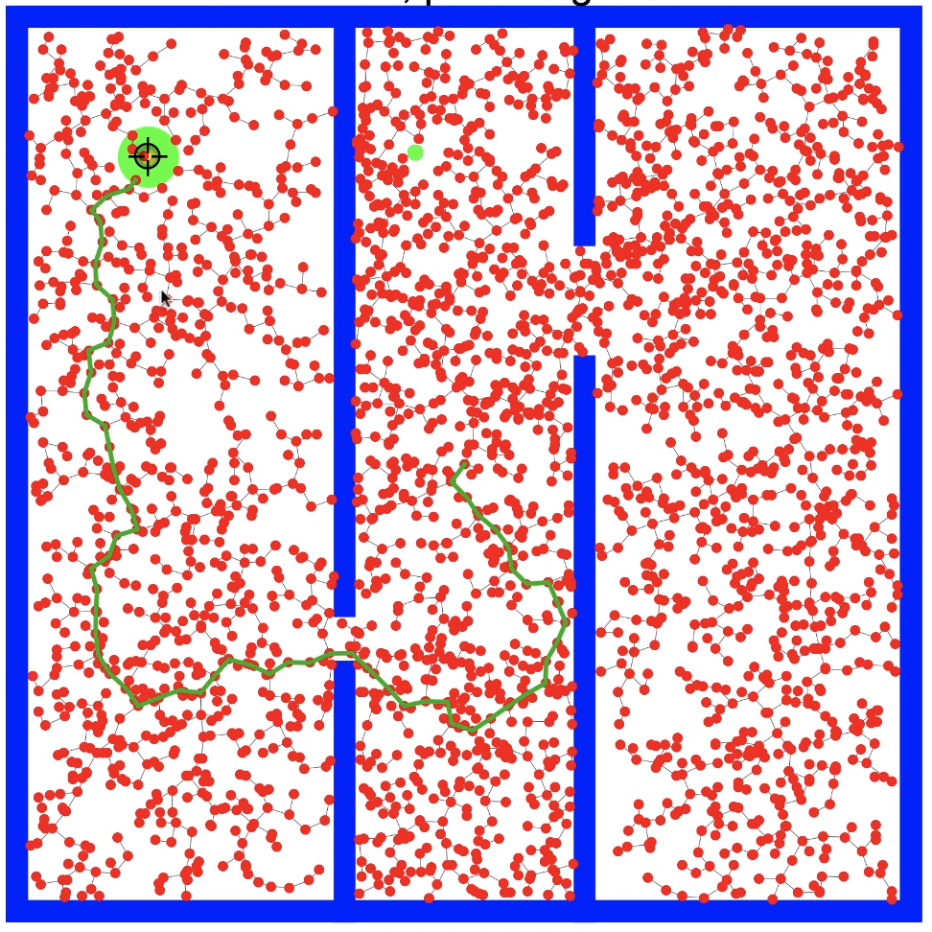
Rapidly-Exploring Random Trees (RRT)
Code:
Start, End
Counter = 0 - keeps track of iterations
lim - number of iterations algorithm should run for
G(V,E)
While counter < lim:
Xnew = Choose random position (using collision detection)
Xnearest = Select the nearest node this this position.
New_edge = Edge(Xnew, Xnearest)
G.append(new_edge)
if Xnew == end (or close):
Return G
Return G
Find path (if exist) – but not optimal
Complexity = $O\left(nlog(n)\right)$

Slide 15
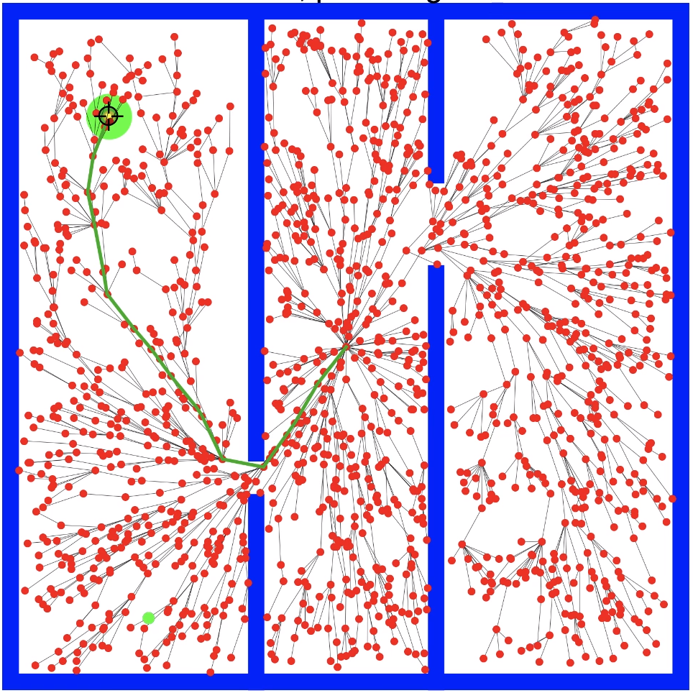
RRT* Algorithm
Rad = r
G(V,E)
For i in range(0…n):
Xnew = = Choose random position (using collision detection)
Xnearest = Select the nearest node this this position.
Cost(Xnew) = Distance(Xnew, Xnearest)
Xbest, Xneighbors = findNeighbors(Xnew, Rad)
Link = Chain(Xnew, Xbest)
For x in Xneighbors
If Cost(Xnew) + Distance(Xnew,x) < Cost(x)
Cost(x) = Cost(Xnew)+Distance(Xnew,x)
Parent(x) = Xnew
G += {Xnew,x}
G += Link
Return G
Complexity = $O\left(nlog(n)\right)$

Slide 16
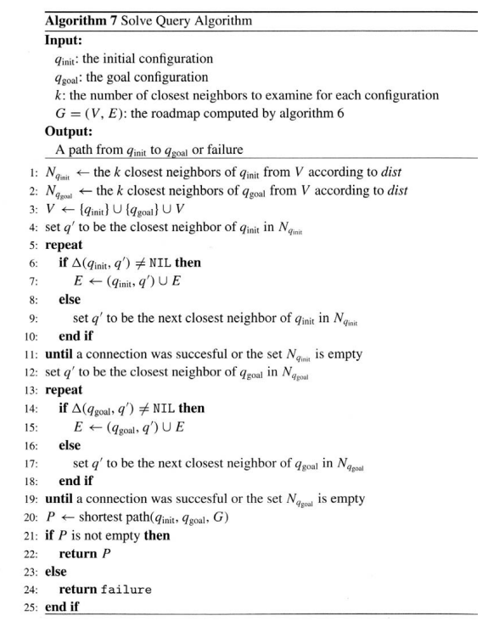
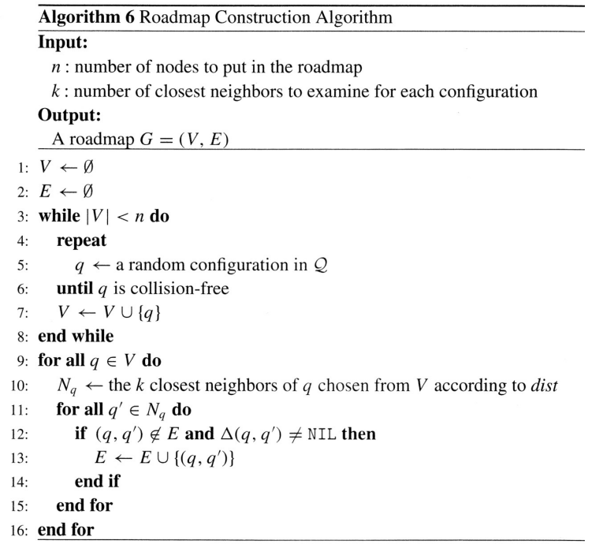
Probabilistic Road-Map (PRM) Algorithm
Step 1 – learning the map:
Initially empty graph
chose
Complexity = Dijkstra’s complexity (worst case)

Slide 17
END
START

Slide 18
